Slide 1
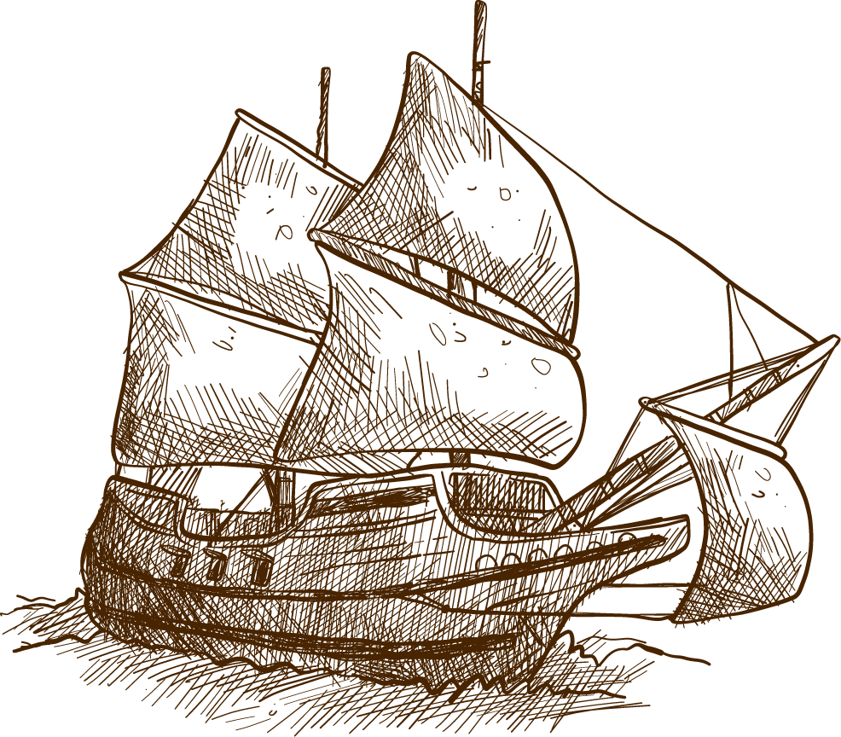
FUNCTIONS OF METAPHOR

Slide 2
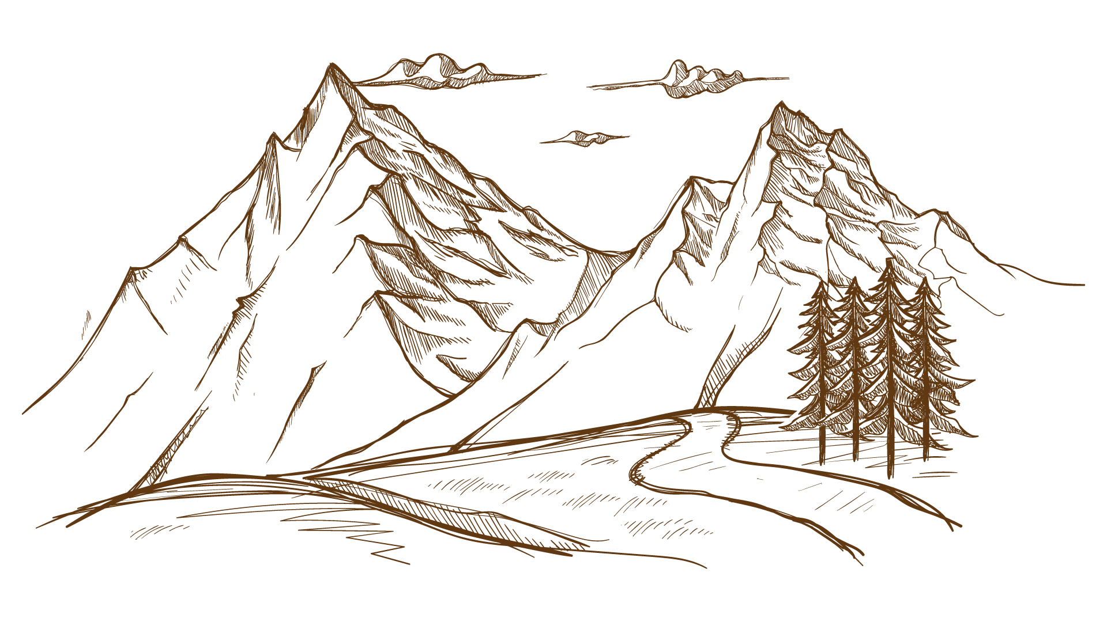
FUNCTION OF METAPHOR
Metaphors can have different functions in various contexts of human communication. The three main functions of metaphor are emotive, persuasive, and cognitive functions. In the first, a metaphor serves to express and transfer emotional attitudes; in the second, it serves to persuade the audience with respect to a course of action or a point of view; and in the third, it serves to express cognitive insights.

Slide 3

IN LITERATURE
The function of metaphor in literature is twofold
- The first, and more practical, the function is to allow the reader a greater understanding of the concept, object, or character being described.
- The second function is purely artistic: to create an image that is beautiful or profound or otherwise produces the effect that the writer desires. The metaphor in literature serves to make writing more accessible and colorful at the same time.

Slide 4
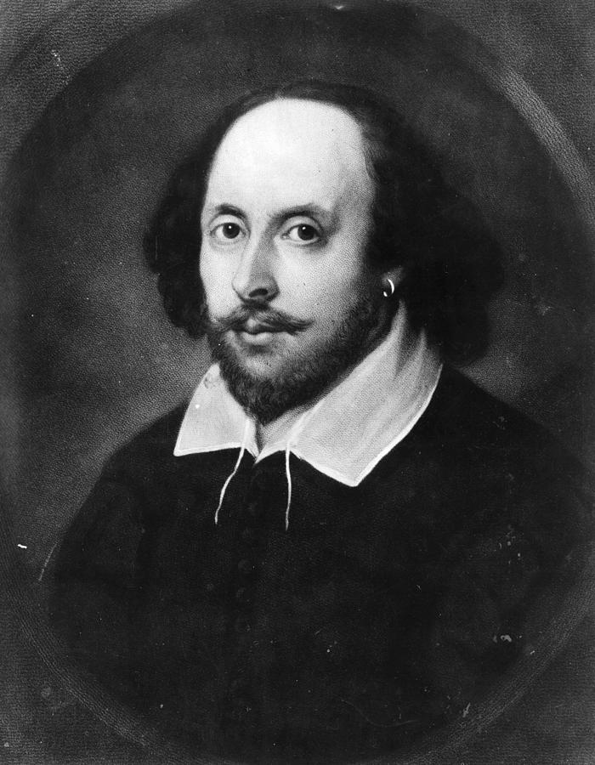
—William Shakespeare
“All the world's a stage, and all the men and women merely players”

Slide 5

The metaphor here is a psychological as well as literary technique to help create understanding. It can also help us think differently about ideas or see things in new ways. For a writer, it is a way of using language to manipulate the way the reader responds. Metaphor allows a writer to control the way readers perceive what's been written. A metaphor has the effect of showing a thing in a way that shines a new light on it and a skilled writer can use it to illustrate a character's viewpoint as well as illuminate the narrator's point of view.

Slide 6
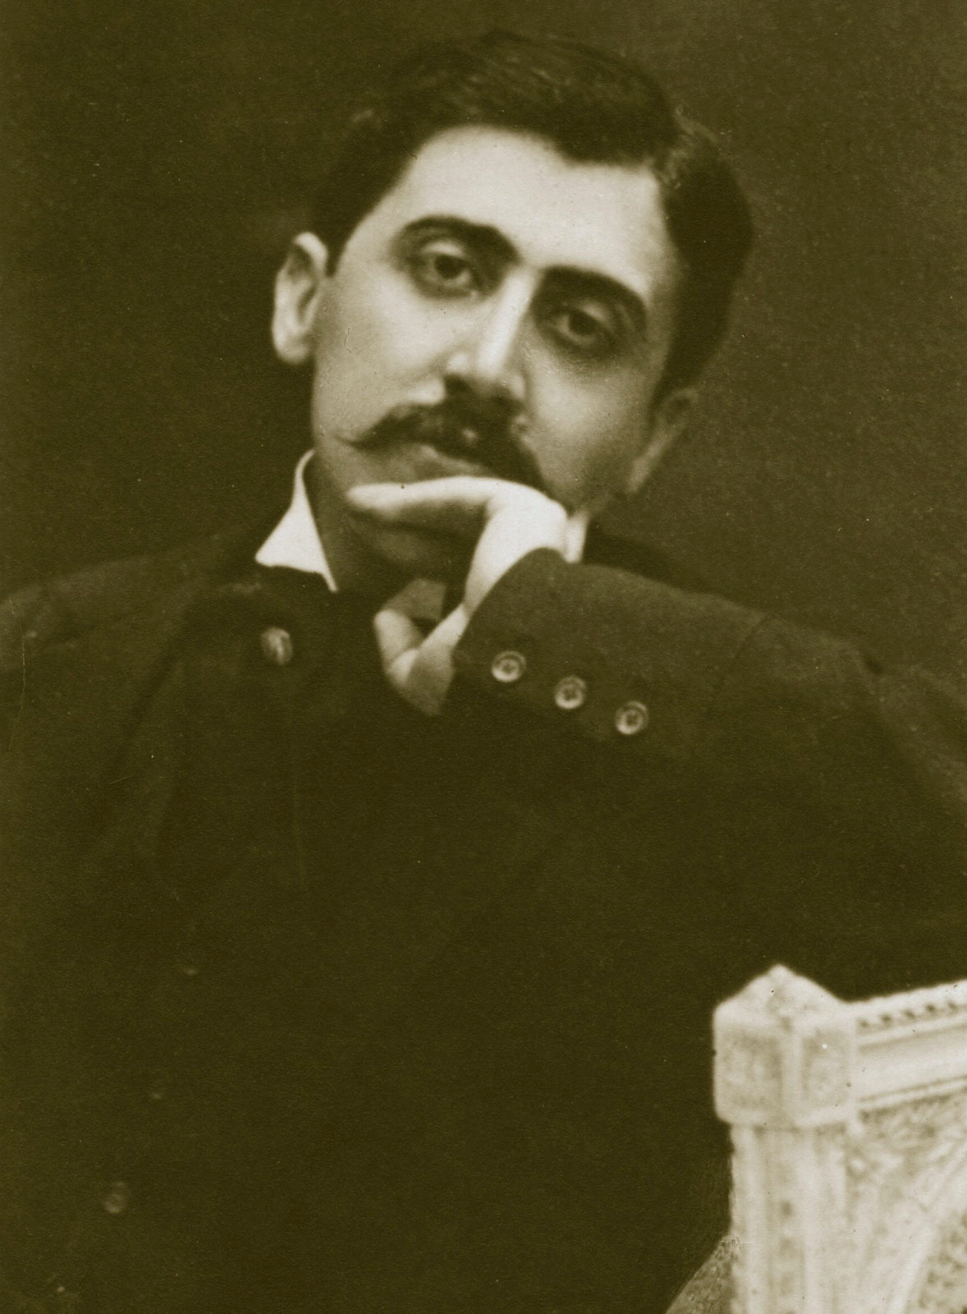
—Marcel Proust
“Let us be grateful to people who make us happy, they are the charming gardeners who make our souls blossom.”

Slide 7
Using metaphor allows a writer to create images related to dreaming, and use words to beautiful effect. One effect of metaphor on the reader is that it forces readers to think and interpret for themselves, creates connection and empathy – because metaphor delivers more than literal significance, it can make a reader understand something at a deeper level than any literal description. Metaphors in poetic language appeal directly to the senses, and one reason poets often use metaphor is to describe things that can't be said in ordinary language. This is not just an effective use of language – it contributes to creating an individual voice and style for a writer.

Slide 8
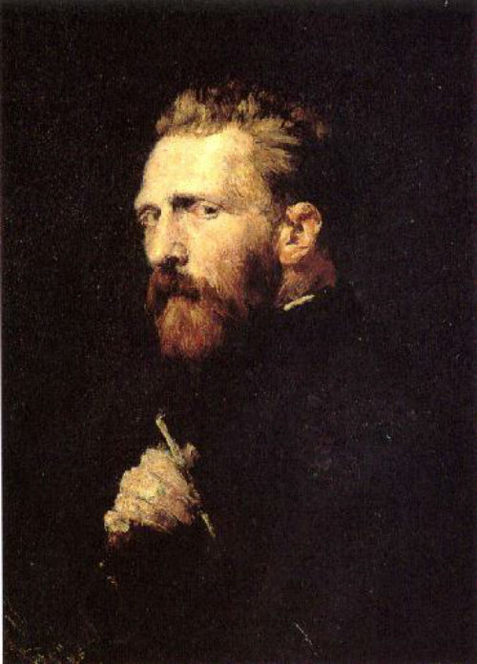
—Vincent Van Gogh
“Conscience is a man’s compass.”

Slide 9
Along with the development of social life, people's awareness is increasingly enhanced. People are discovering more and more things and phenomena around them, and those phenomena are becoming more and more comprehensive and profound. But the number of words to express those perceptions is limited. Therefore, it is imperative to have different ways of using a finite number of words to satisfy the growing need for awareness. Thus, metaphor has contributed to making language meet the increasing development of human perception.

Slide 10

Some examples of typical metaphor in literature

Slide 11
"This momentous decree came as a great beacon light of hope to millions of Negro slaves who had been seared in the flames of withering injustice. It came as a joyous daybreak to end the long night of their captivity. Now is the time to rise from the dark and desolate valley of segregation to the sunlit path of racial justice.“
-Martin Luther King’s “I Have a Dream” speech

Slide 12
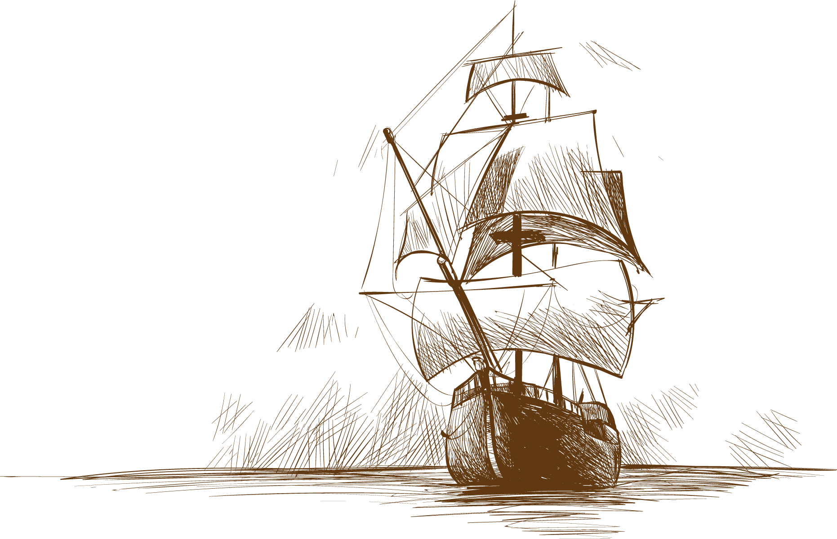
"But one hundred years later, the Negro still is not free. One hundred years later, the life of the Negro is still sadly crippled by the manacles of segregation and the chains of discrimination. One hundred years later, the Negro lives on a lonely island of poverty in the midst of a vast ocean of material prosperity. One hundred years later, the Negro is still languished in the corners of American society and finds himself an exile in his own land."
-Martin Luther King’s “I Have a Dream” speech

Slide 13
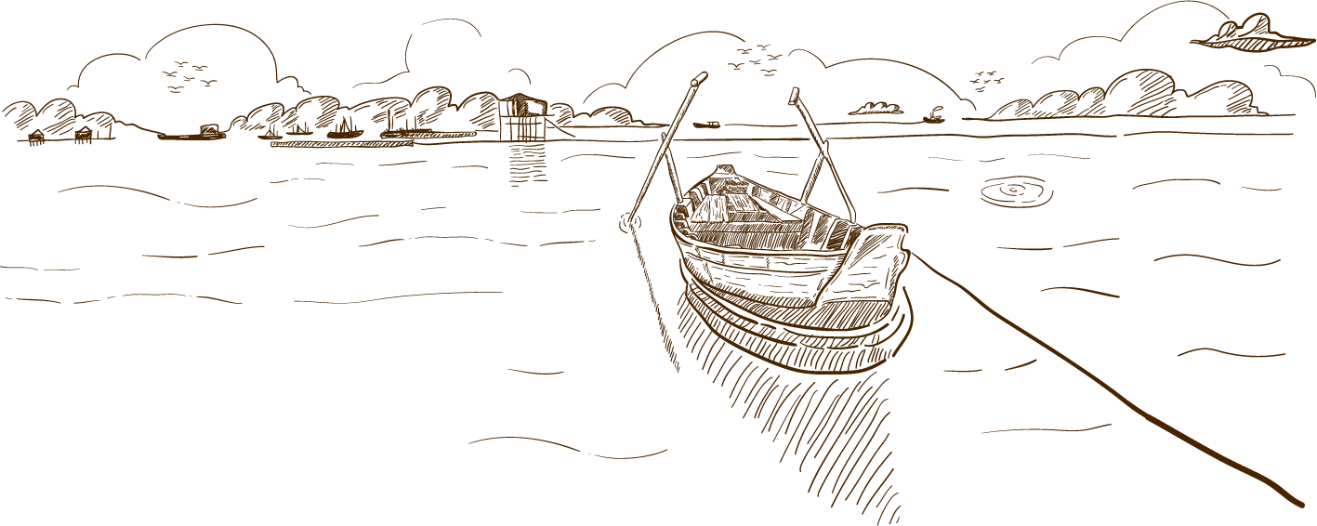
CONCLUSION

Slide 14
By looking at the metaphor in a more profound way, we have discovered that it is a form of a figure of speech that replaces the name of an item, situation, or action with something that it is not. It is a more creative and expressive way to show the literal meaning of something without using literal speech.
Metaphors are extremely common in spoken English and can be regularly heard in day-to-day conversation. They are also very popular for use in writing, whether that is in song, script, poetry, or otherwise, enabling the writer to add more emotional and deep meaning to a statement.

Slide 15
01
03
OVERVIEW
ASSIGNMENT
02
FEATURES OF THE TOPIC
04
ABOUT THE TOPIC

Slide 16
PROCESS
Mercury is the closest planet to the Sun
Despite being red, it’s actually a cold place
1390
MERCURY
1530
MARS
VENUS
1450
SATURN
1610
Venus is the second planet from the Sun
It’s composed of hydrogen and helium

Slide 17
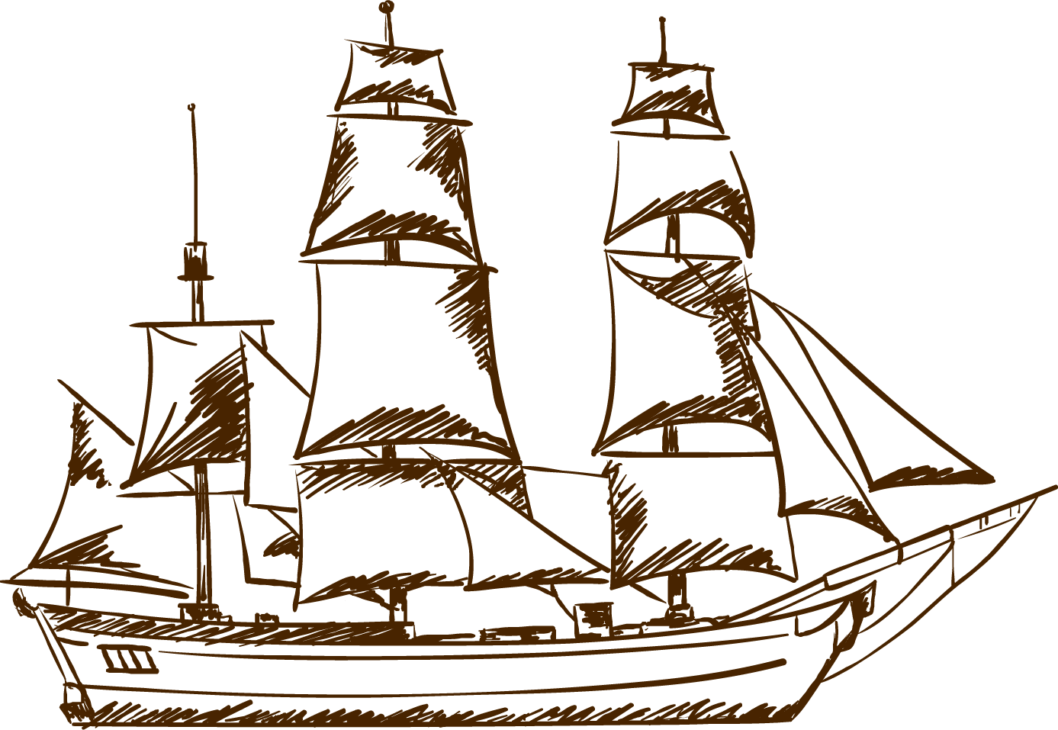
EXERCISE
Fill in the blanks with the name of each part
_____
_____
_____
Mercury is the smallest of them all
Despite being red, Mars is a cold place
Venus has a beautiful name, but it’s too hot

Slide 18
THANKS
Do you have any questions?
youremail@freepik.com
+91 620 421 838
yourcompany.com
Please keep this slide for attribution

Slide 19
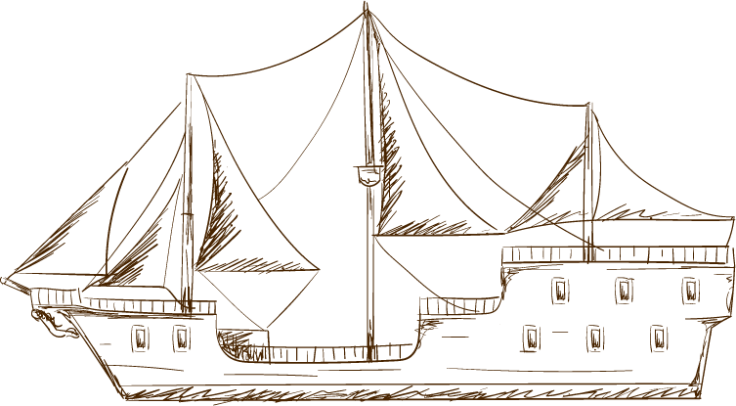



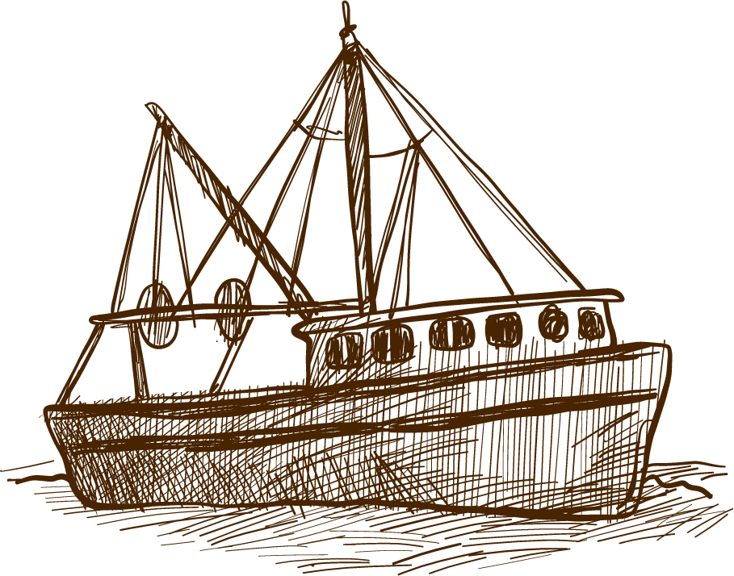




ALTERNATIVE RESOURCES

